Slide 1
Secure Software Development
An Introduction to the
OWASP Top 10 Most Critical Web
Application Security Risks
David Walker

Slide 2
Overview
Review the OWASP Top Ten List
Provide Remediation Steps for Developers
Looking for Developers Involvement in Enhancing Remediation Steps for Specific Languages

Slide 3
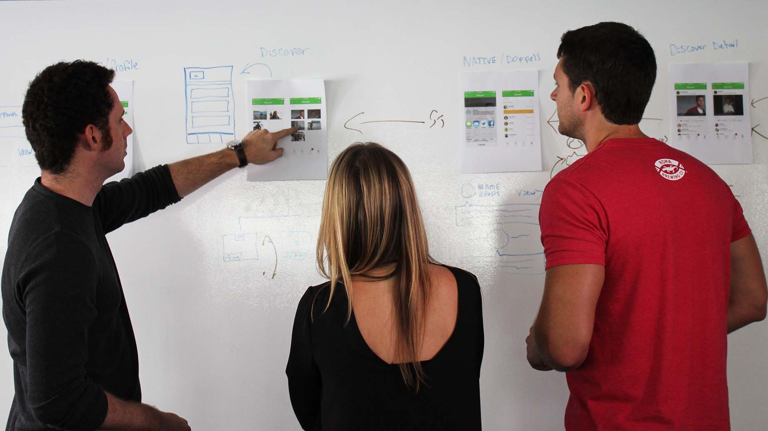
Why Talk Security with Developers?
If we examine the attack path of successful breaches out there, we find that many of them are preventable by improving our coding practices.
In fact, the number one vulnerability on the OWASP Top Ten is injection attacks. Injection attacks have been documented and publicized for 20 years now and yet they are still number one on the list.
I believe that if we discover or develop good coding practices and share with each other, that we can wipe out OWASP Top Ten related vulnerabilities in our code, improve the quality of our code, and improve our communication and mindset to reduce vulnerabilities across the board.

Slide 4

Secure Software Consultant
Sr. Software Developer
CSSLP
Certified Secure Software Lifecycle Professional
CSSLP Exam Development
Conference Speaker
David Walker

Slide 5
OWASP Top 10
Application Security Risks – 2017
A1 Injection Flaws
A2 Broken Authentication
A3 Sensitive Data Exposure
A4 XML External Entities (XXE)
A5 Broken Access Control
A6 Security Misconfiguration
A7 Cross Site Scripting (XSS)
A8 Insecure Deserialization
A9 Components With Known Vulnerabilities
A10 Insufficient Logging and Monitoring

Slide 6
INJECTION FLAWS
Flaws in the creation of objects or commands allow attackers to break out of a data field and issue their own commands

Slide 7
INJECTION ATTACKS
In the 1960s, Whistler and Captain Crunch (not their real names), among others, discovered they could make free long-distance calls by injecting 2600 hz tones into the phone lines
In 1998, Rain Forest Puppy (also not his real name) published an article describing a vulnerability in how many applications handle parameters when creating SQL statements

Slide 8
INJECTION ATTACKS - REMEDIATION
Injection attacks happen when values are handled improperly when creating an object or a command
Never use simple string concatenation to create an object or a command
Use parameterized queries for SQL statements
Use components to manipulate XML, JSON, LDAP
Test inputs using common reserved characters

Slide 9
BROKEN AUTHENTICATION
Incorrect implementations enable attackers to compromise passwords, keys, or session tokens and temporarily or permanently assume an identity

Slide 10
BROKEN AUTHENTICATION - REMEDIATION
SSL everywhere
Strong passwords
Authentication, authorization, and session management components from trusted sources
Understand the flow of the passwords, keys, and session tokens throughout the system
Audit Log Monitoring. Detecting anomalies could reveal the assumption of an identity

Slide 11
SENSITIVE DATA EXPOSURE
Sensitive data not encrypted in transit
Sensitive data stored unencrypted in cache

Slide 12
SENSITIVE DATA EXPOSURE - REMEDIATION
SSL everywhere
Limit the sensitive data that is transferred out of your controlled environment
Encrypt the sensitive data during transfer
Avoid allowing sensitive data to be cached
Require encryption of sensitive data anywhere it is stored
on the server
in cache
after download

Slide 13
XML EXTERNAL ENTITIES (XXE)
Weakly configured XML parsers resolve external entities leading to information disclosure or remote code execution

Slide 14
XML EXTERNAL ENTITIES (XXE) ATTACKS - REMEDIATION
Related to injection attacks and deserialization attacks, but important enough to get its own listing
The nice thing about this one is that it is generally pretty easy to remedy. Download the XXE prevention cheat sheet, look up your technology, and if you have an issue, fix it
https://www.owasp.org/index.php/XML_External_Entity_(XXE)_Prevention_Cheat_Sheet

Slide 15
BROKEN ACCESS CONTROL
Access control protections are not properly enforced

Slide 16
BROKEN ACCESS CONTROL - REMEDIATION
Test API endpoint security
Test permissions on all services visible on the network
Database server
Caching server
Document database
LDAP
Etc

Slide 17
SECURITY MISCONFIGURATION
Insecure configurations of operating systems, frameworks, libraries, and applications

Slide 18
SECURITY MISCONFIGURATION - REMEDIATION
Run server applications with minimal permissions, minimum required abilities
Never run as administrator or root
SSL everywhere
Protect SSL private keys
Turn off all non-essential network services
Research hardening guides for additional recommendations

Slide 19
CROSS SITE SCRIPTING (XSS)
HTML/JavaScript Injection Attack
Injecting illicit HTML and/or JavaScript into dynamic web pages to run commands in the context of the user

Slide 20
CROSS SITE SCRIPTING (XSS) - REMEDIATION
Remediation is tricky because the dangerous values would be perfectly valid if you were authoring the html
Rich text values coming from the client must be filtered at the server, particularly if they are html. Tags, attributes, and values must all be tested depending on your requirements
Use a Content Security Policy header to lock down permissible URLs for images, scripts, etc.

Slide 21
INSECURE DESERIALIZATION
Deserialization without strict type constraints allows attackers to create and abuse objects in the system

Slide 22
INSECURE DESERIALIZATION - REMEDIATION
Always restrict the types available to the deserializer of untrusted objects
For example in C#/Newtonsoft.Json keep the TypeNameHandling set to None, or use an ISerializationBinder to throw an exception for an unrecognized type

Slide 23
COMPONENTS WITH KNOWN VULNERABILITIES
Continued use of components with known vulnerabilities due to lack of knowledge or understanding of the severity of those vulnerabilities

Slide 24
COMPONENTS WITH KNOWN VULNERABILITIES
- REMEDIATION
Periodic review of software components to discover know vulnerabilities
Monitor security announcements for critical vulnerabilities
The more critical your application and the data it protects, the more frequent and vigilant the reviews should be

Slide 25
INSUFFICIENT LOGGING AND MONITORING
Insufficient logging, monitoring, and incident response plans allow attackers to go undetected longer and burrow deeper into the system

Slide 26
INSUFFICIENT LOGGING AND MONITORING
- REMEDIATION
Log enough data to reconstruct issues
Use correlation identifiers to tie log entries together
Model attacks and configure logging to detect them
Well-known and tested incident response plan

Slide 27

Stay Secure Out There
If you have questions or would like more information, feel free to contact me.
Email: david.walker@agilethought.com
Twitter: @grax
LinkedIn: https://www.linkedin.com/in/davidalanwalker/

